Slide 1


Loan Default Prediction
Presented by Minh Nguyen

Slide 2
BIO
Education:
Bachelor of Software Engineering (UTS) (2002 – 2006)
Master of Quantitative Finance (UTS) (2007 – 2010)
Experience:
Trading Analyst at IMC Pacific 2007- 2014
Business Owner @ The Garden Café Erskineville (2015 – 2020)

Slide 3
Agenda
Lending Club Overview
Business Problem
Exploring Data Analysis
Project Pipeline
Model Evaluation
Conclusion

Slide 4
Overview
LendingClub
LendingClub is the world's largest peer-to-peer lending platform.
LC charge an origination fee to borrowers (~3% - 6%) and a service fee to investors (~1%)
Other fees: dishonour fees, late payments fee
As of December 31, 2015, the company claims $15.98 billion in loans.
Investors
Open Account
Build investment portfolio
Investment strategy: risk vs return
Leverage high return (i.e: borrow at cheaper rate from bank to lend at higher rate)
Borrowers
Accessible to most borrowers
Personal loans up to $40,000
Business Loans up to $500K
Funds available in as soon as four days
Rate ~ 8.05% – 35.89%
Notes:
Service fee:
https://help.lendingclub.com/hc/en-us/articles/216118467-How-is-the-service-fee-collected-#:~:text=LendingClub%20charges%20an%20investor%20service,more%20or%20less%20than%201%25.
https://www.bankrate.com/loans/personal-loans/reviews/lending-club/
Loan Status:
https://help.lendingclub.com/hc/en-us/articles/216109367-What-do-the-different-Note-statuses-mean-#:~:text=Charged%20Off%3A%20Loan%20for%20which,deducted%20from%20the%20account%20balance.

Slide 5
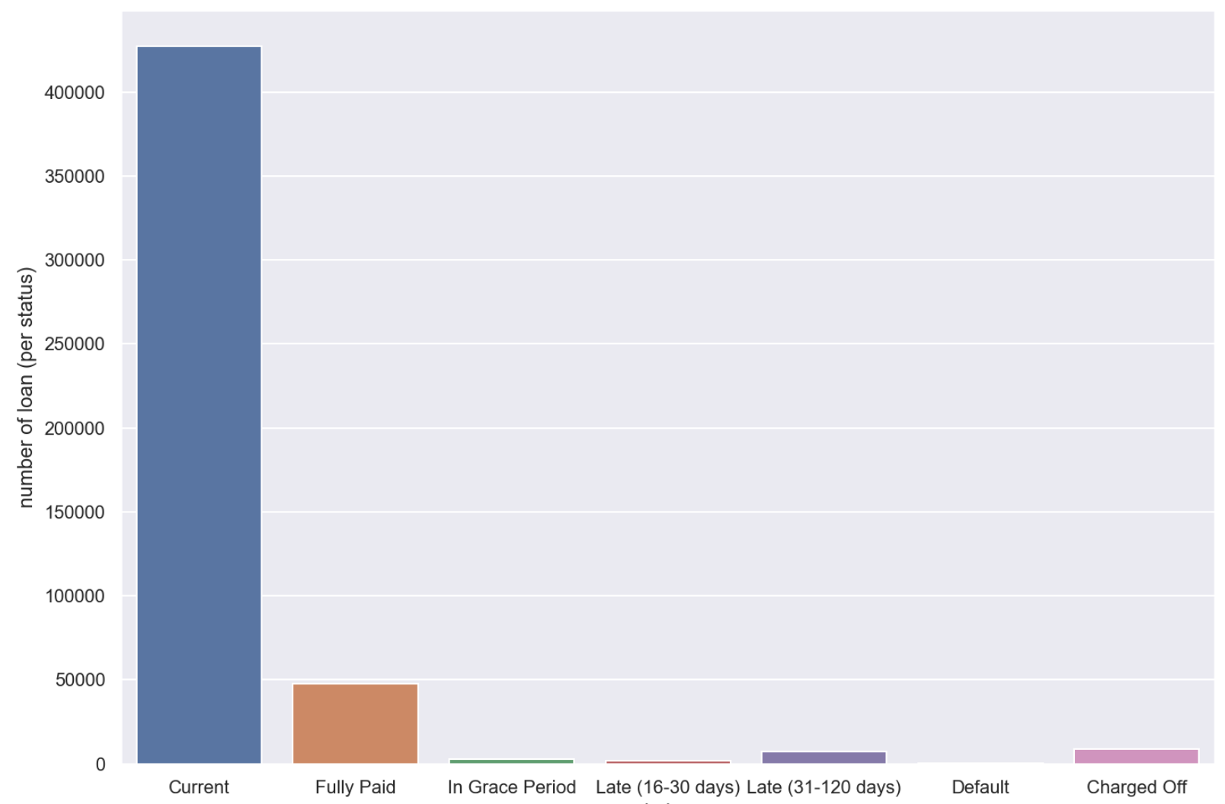
Business Problem
Number of Application Over Loan Status 2018
Current: Loan is up to date on all outstanding payments.
Fully paid: Loan has been fully repaid
In Grace Period: Loan is past due but within the 15-day.
Late (16-30): Loan has not been current for 16 to 30 days
Late (31-120): Loan has not been current for 31 to 120 days.
Default: Loan has not been current for 121 days or more.
Charged Off: Loan for which there is no longer a reasonable expectation of further payments.

Slide 6
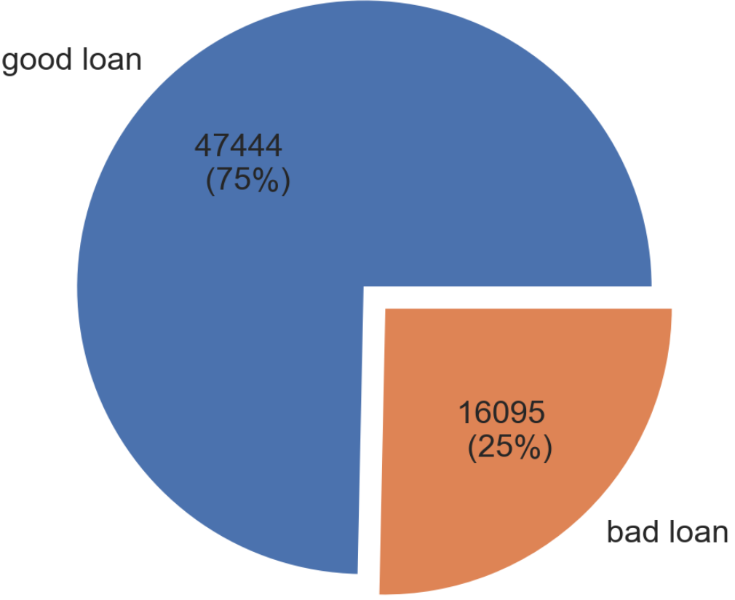
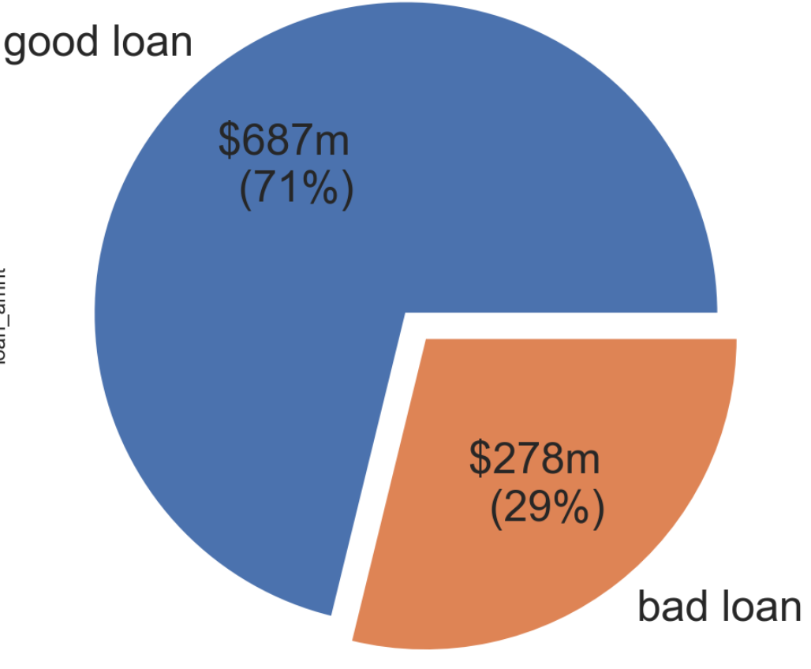
Business Problem
Remove: [Current, In Grace Period, Late (16-30)]
Classify loans into:
Good Loan: [Fully paid]
Bad Loan: [Late (31-120), Default, Charged Off]
Number of applications
per classification
Total $ value
per classification
Stakeholder: Investors
Question: Can we use the information provided by LC to investors (before the application is funded) to predict a good loan and reduce the risk of a bad loan?

Slide 7
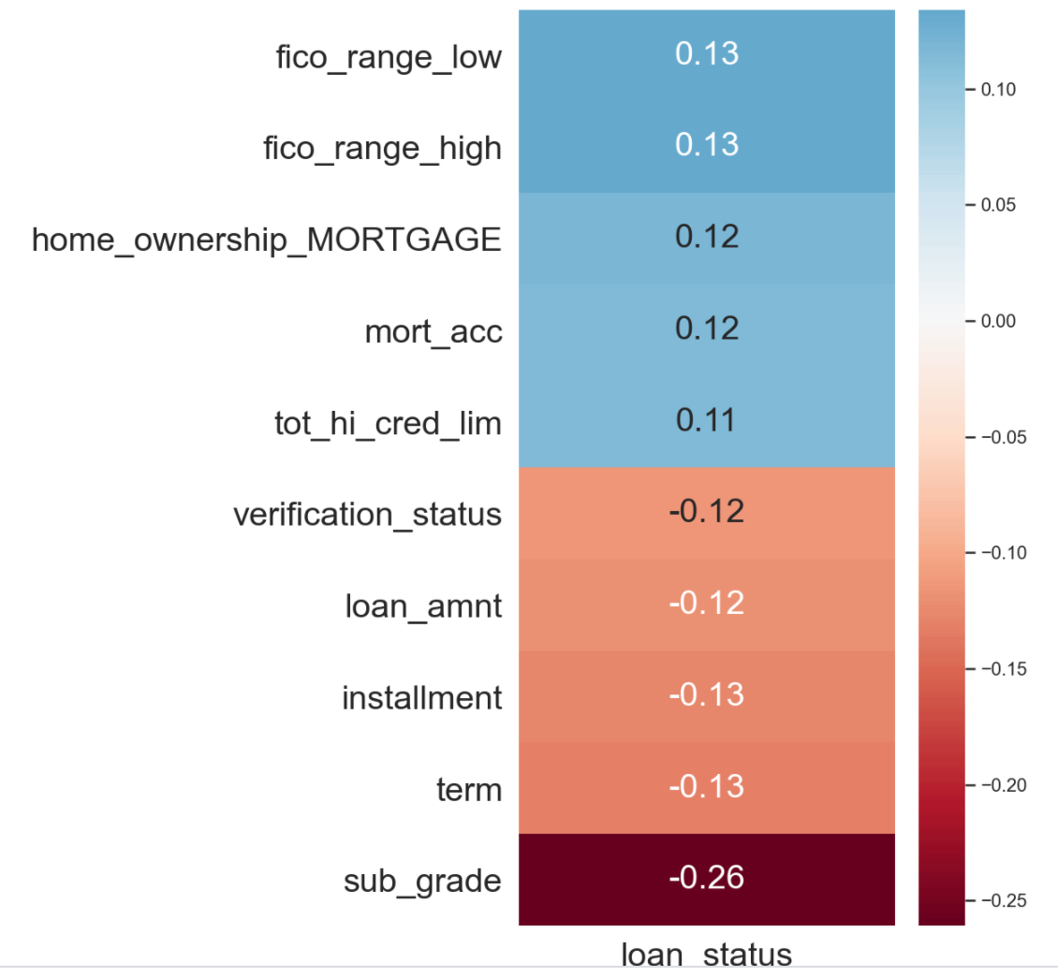
Exploring Data Analysis
Historical data since 2007: 2.5Gb+ memory of records, 2m+ rows x 149 features
Most recent data 2018: 570.5Mb+ memory of records, 495,242 Rows x 149 features
Many features only available after the loan is accepted and funded (payment update, late fees, etc..)
After clean data and feature engineering, we have 83 relevant features
Top 10 correlated features to the loan status
Subgrade: rating assigned by LC based on credit history check and borrower provided information

Slide 8
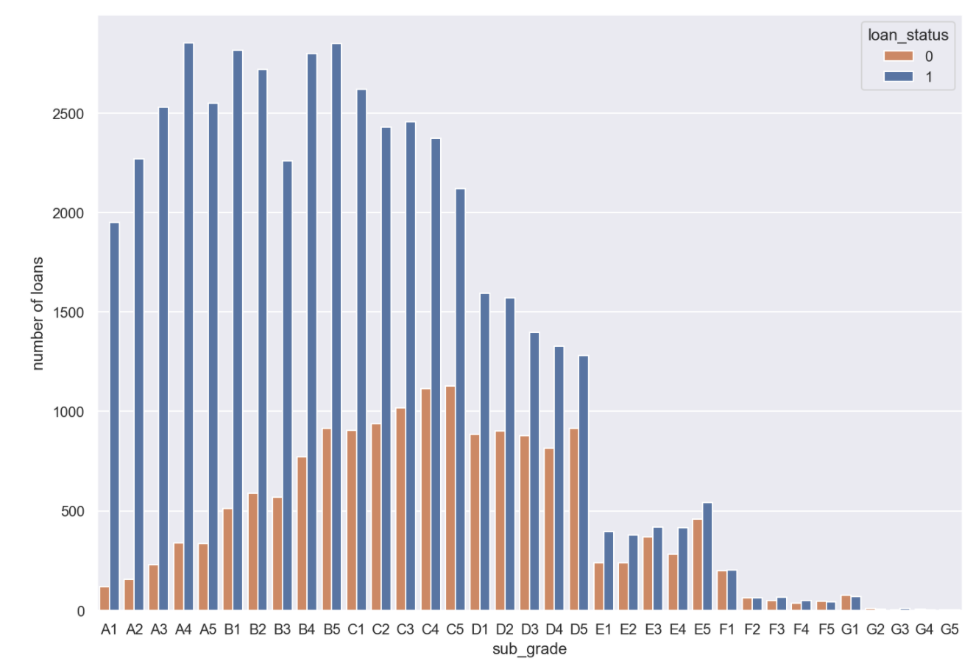
Exploring Data Analysis
Loan distribution over grading

Slide 9
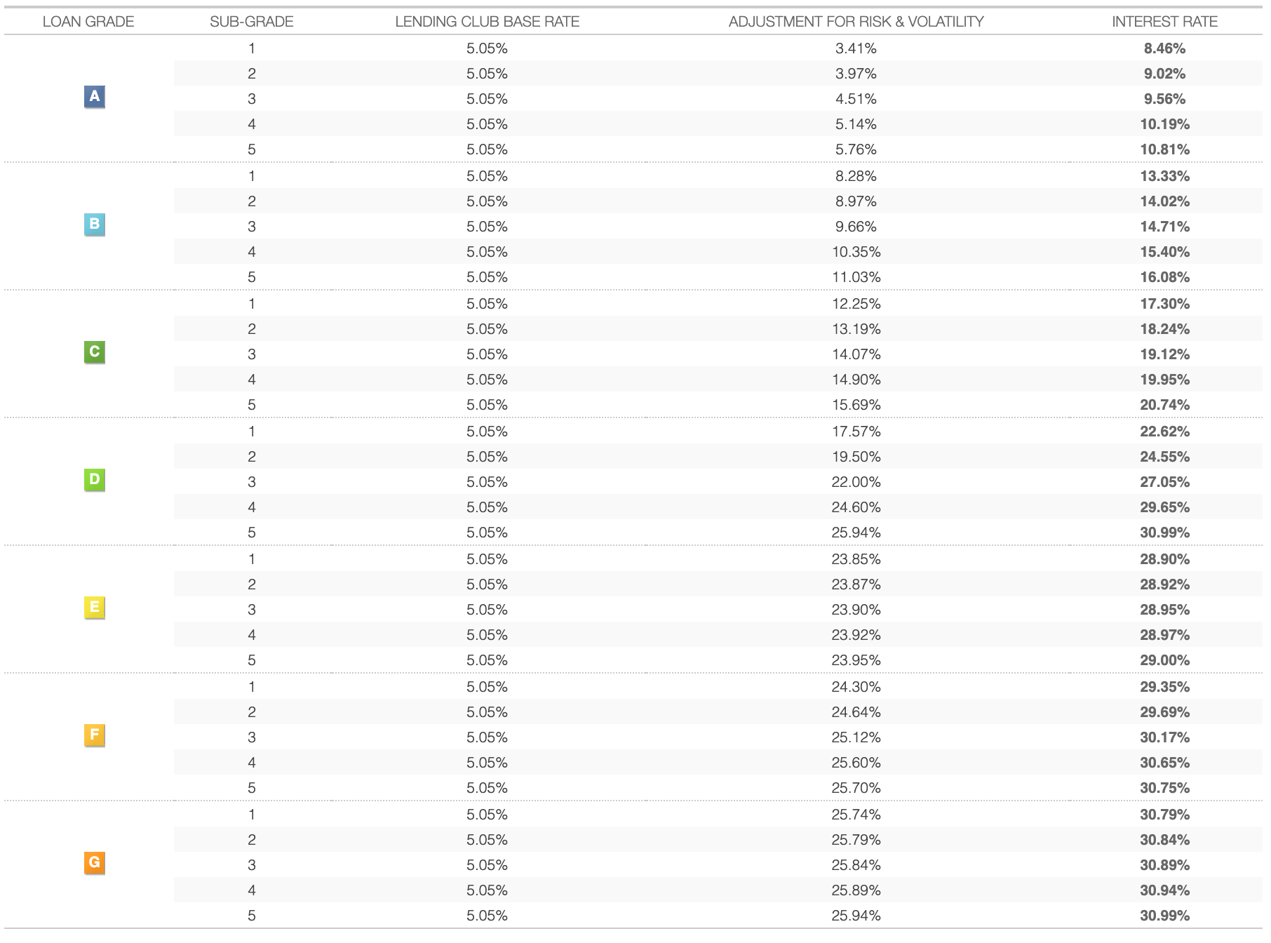
Exploring Data Analysis

Slide 10
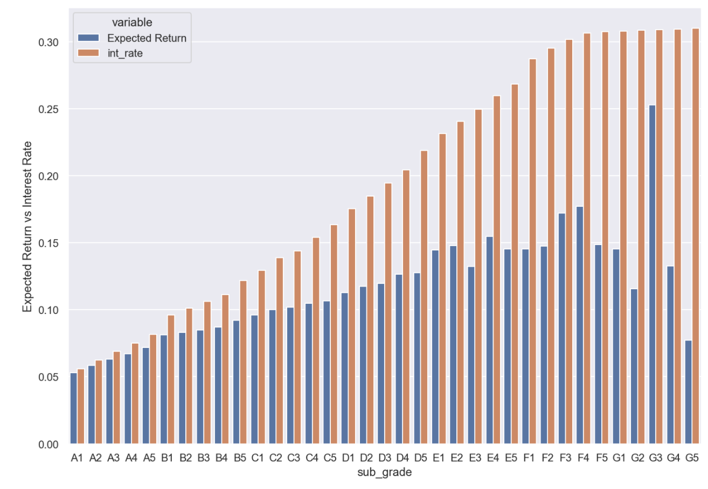
Exploring Data Analysis

Slide 11
Project Pipeline
Ridge, Logistic Regression, Naïve Bayes, SVM, K-NN, Decision Tree
Random Forest Gradient Boosting
AdaBoost, XGB,
Neural Network
Data Cleaning & Feature Selection
Model Valuation & Parameter Optimization
Model Design
Model Implementation
63539 rows x 83 features
Split data into 70% train – 30% test
Select best model
& tuning parameters

Slide 12
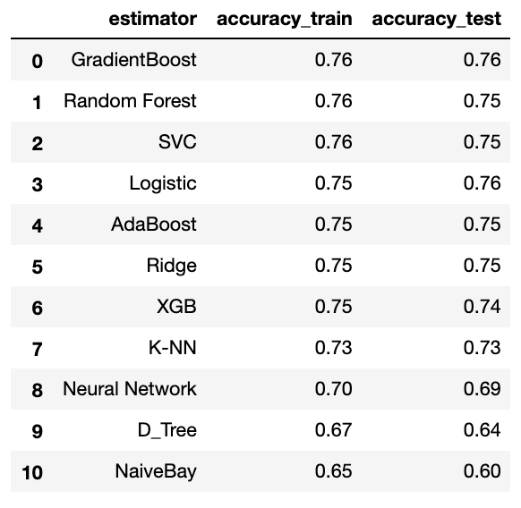
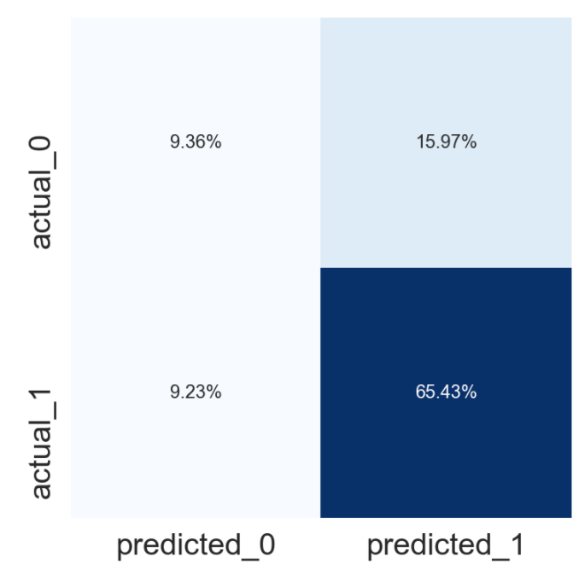
Model Valuation
Use model for investment portfolio:
Remove the predicted 0 (18.5%)
Predict 1 with (~16/65) error ratio ~ 80% accuracy

Slide 13
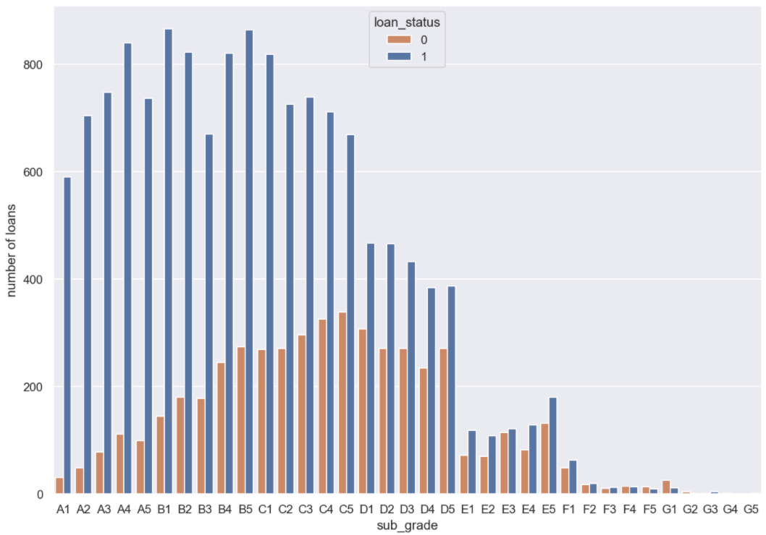
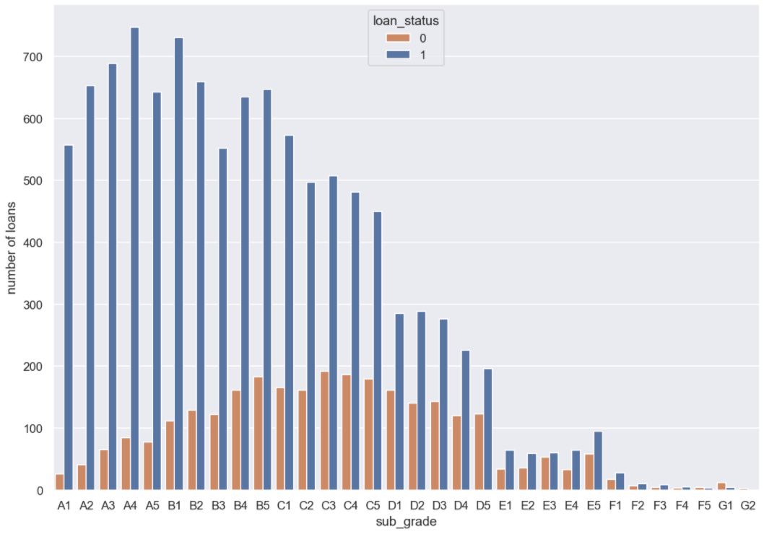
Conclusion & Further works
Original Distribution
Remove ~18.5% of application predicted 0
Improve good loan/total loan ratio from 75% to 80%
There are a certain risks even in the high credit score groups. (Bias information only the borrowers know)
Using ML Model can reduce the portfolio risk (reduce risk from 25% to 20%)
Can further improve the result depending on the investment strategy.
Can we use the information provided by LC to investors (before the application is funded) to predict a good loan and reduce the risk of a bad loan?
YES! At 80% accuracy
Distribution
with GradientBoost model prediction

Slide 14
Thanks!
Any Questions?
Supporting Documents:
https://github.com/nguyenkminh/LendingClub.git

